Slide 1
Programación orientada a Objetos
Construyendo Clases

Slide 2
Arrays
Array o arreglo
  Grupo de ubicaciones de memoria contiguos
    Comparten un mismo nombre
    Tienen el mismo TIPO

Slide 3
Nombre del array (Note que todos se llaman ”c”)
c[ 0 ]
-45
6
0
72
1543
-89
0
62
-3
1
6453
78
c[ 1 ]
c[ 2 ]
c[ 3 ]
c[ 4 ]
c[ 5 ]
c[ 6 ]
c[ 7 ]
c[ 8 ]
Número de posición (indice
o subindice) del elemento en el array c
c[ 9 ]
c[ 10 ]
c[ 11 ]
Fig. 7.1 Array de 12 elementos.

Slide 4
Arrays (cont.)
Subindice
  O indice
  Número de posición dentro de brackets o corchetes
  Debe ser entero o variable entera
  a = 5;
  b = 6;
  c[ a + b ] += 2;
    Suma 2 a c[ 11 ]

Slide 5
Arrays (cont.)
Examine el array c
  c es el nombre del array
  c.length contiene la longitud del array c
  c tiene 12 elementos ( c[0], c[1], … c[11] )
    El valor de c[0] es –45

Slide 6
Declarando y Ubicando Arrays
Declaración y ubicación
  Arrays son objectos que ocupan memoria
  Se les ubica dinámicamente con el operador new
    int c[] = new int[ 12 ];
      Equivale a:
      int c[]; // declara array
      c = new int[ 12 ]; // ubica array
    Se pueden ubicar arrays de objetos también
      String b[] = new String[ 100 ];

Slide 7
Ejemplos con Arrays
Declarando arrays
Ubicando arrays
Inicializando arrays
Manipulando elementos de un array

Slide 8
Ubicando un Array e inicializando sus elementos
Como
  Declarar array
  Ubicar array
  Inicializar sus elementos

Slide 9
InitArray.java
Line 12
Declare array as an array of ints
Line 14
Allocate 10 ints for array; each int is initialized to 0 by default
Line 19 array.length returns length of array
Line 20 array[counter] returns int associated with index in array
1 // Fig. 7.3: InitArray.java
2 // Creating an array.
3
4 // Java extension packages
5 import javax.swing.*;
6
7 public class InitArray {
8
9 // main method begins execution of Java application
10 public static void main( String args[] )
11 {
12 int array[]; // declare reference to an array
13
14 array = new int[ 10 ]; // dynamically allocate array
15
16 String output = "Subscript\tValue\n";
17
18 // append each array element's value to String output
19 for ( int counter = 0; counter < array.length; counter++ )
20 output += counter + "\t" + array[ counter ] + "\n";
21
22 JTextArea outputArea = new JTextArea();
23 outputArea.setText( output );
24
25 JOptionPane.showMessageDialog( null, outputArea,
26 "Initializing an Array of int Values",
27 JOptionPane.INFORMATION_MESSAGE );
28
29 System.exit( 0 );
30 }
31 }
Declare array as an array of ints
Allocate 10 ints for array; each int is initialized to 0 by default
array.length returns length of array
array[counter] returns int associated with index in array

Slide 10
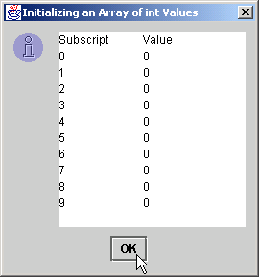
InitArray.java
Each int is initialized to 0 by default
Each int is initialized to 0 by default

Slide 11
Usando una lista para inicializar los elementos de un array
Inicializando elementos
  Usar una lista
    Items encerrados en llaves ({})
    Y separados por comas
    int n[] = { 10, 20, 30, 40, 50 };
      Crea un array de 5 elementos
      Subindices son 0, 1, 2, 3, 4
  No necesito usar new

Slide 12
InitArray.java
Line 14
Declare array as an array of ints
Line 14
Compiler uses initializer list to allocate array
1 // Fig. 7.4: InitArray.java
2 // Initializing an array with a declaration.
3
4 // Java extension packages
5 import javax.swing.*;
6
7 public class InitArray {
8
9 // main method begins execution of Java application
10 public static void main( String args[] )
11 {
12 // initializer list specifies number of elements and
13 // value for each element
14 int array[] = { 32, 27, 64, 18, 95, 14, 90, 70, 60, 37 };
15
16 String output = "Subscript\tValue\n";
17
18 // append each array element's value to String output
19 for ( int counter = 0; counter < array.length; counter++ )
20 output += counter + "\t" + array[ counter ] + "\n";
21
22 JTextArea outputArea = new JTextArea();
23 outputArea.setText( output );
24
25 JOptionPane.showMessageDialog( null, outputArea,
26 "Initializing an Array with a Declaration",
27 JOptionPane.INFORMATION_MESSAGE );
28
29 System.exit( 0 );
30 }
31 }
Declare array as an array of ints
Compiler uses initializer list to allocate array

Slide 13
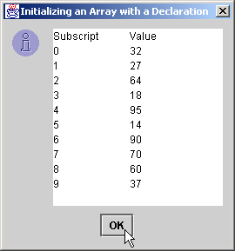
InitArray.java
Each array element corresponds to element in initializer list
Each array element corresponds to element in initializer list

Slide 14
Calculando el valor a guardar en cada elemento
Calculando valores
  Inicializar elementos de un array tamaño 10 a los números pares

Slide 15
InitArray.java
Line 13
Declare array as an array of ints
Line 15
Allocate 10 ints for array
Line 19
Use array subscript to assign array value
1 // Fig. 7.5: InitArray.java
2 // Initialize array with the even integers from 2 to 20.
3
4 // Java extension packages
5 import javax.swing.*;
6
7 public class InitArray {
8
9 // main method begins execution of Java application
10 public static void main( String args[] )
11 {
12 final int ARRAY_SIZE = 10;
13 int array[]; // reference to int array
14
15 array = new int[ ARRAY_SIZE ]; // allocate array
16
17 // calculate value for each array element
18 for ( int counter = 0; counter < array.length; counter++ )
19 array[ counter ] = 2 + 2 * counter;
20
21 String output = "Subscript\tValue\n";
22
23 for ( int counter = 0; counter < array.length; counter++ )
24 output += counter + "\t" + array[ counter ] + "\n";
25
26 JTextArea outputArea = new JTextArea();
27 outputArea.setText( output );
28
29 JOptionPane.showMessageDialog( null, outputArea,
30 "Initializing to Even Numbers from 2 to 20",
31 JOptionPane.INFORMATION_MESSAGE );
32
33 System.exit( 0 );
34 }
35 }
Declare array as an array of ints
Allocate 10 ints for array
Use array subscript to assign array value

Slide 16
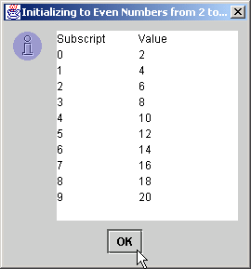
InitArray.java

Slide 17
Sumando los Elementos de un Array
Explotando los elementos
  Se pueden guardar y usar
  Vamos a sumarlos

Slide 18
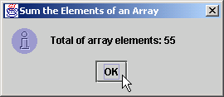
SumArray.java
Line 12
Declare array with initializer list
Line 17
Sum all array values
1 // Fig. 7.6: SumArray.java
2 // Total the values of the elements of an array.
3
4 // Java extension packages
5 import javax.swing.*;
6
7 public class SumArray {
8
9 // main method begins execution of Java application
10 public static void main( String args[] )
11 {
12 int array[] = { 1, 2, 3, 4, 5, 6, 7, 8, 9, 10 };
13 int total = 0;
14
15 // add each element's value to total
16 for ( int counter = 0; counter < array.length; counter++ )
17 total += array[ counter ];
18
19 JOptionPane.showMessageDialog( null,
20 "Total of array elements: " + total,
21 "Sum the Elements of an Array",
22 JOptionPane.INFORMATION_MESSAGE );
23
24 System.exit( 0 );
25 }
26 }
Declare array with initializer list
Sum all array values

Slide 19
Usando los Elementos como contadores
Usar series de contadores para resumir data
  Arrays pueden guardar esos contadores

Slide 20
RollDie.java
Line 12
Declare frequency as array of 7 ints
Lines 15-16
Generate 6000 random integers in range 1-6
Line 19
Increment frequency values at index associated with random number
1 // Fig. 7.8: RollDie.java
2 // Roll a six-sided die 6000 times
3
4 // Java extension packages
5 import javax.swing.*;
6
7 public class RollDie {
8
9 // main method begins execution of Java application
10 public static void main( String args[] )
11 {
12 int face, frequency[] = new int[ 7 ];
13
14 // roll die 6000 times
15 for ( int roll = 1; roll <= 6000; roll++ ) {
16 face = 1 + ( int ) ( Math.random() * 6 );
17
18 // use face value as subscript for frequency array
19 ++frequency[ face ];
20 }
21
22 String output = "Face\tFrequency";
23
24 // append frequencies to String output
25 for ( face = 1; face < frequency.length; face++ )
26 output += "\n" + face + "\t" + frequency[ face ];
27
28 JTextArea outputArea = new JTextArea();
29 outputArea.setText( output );
30
31 JOptionPane.showMessageDialog( null, outputArea,
32 "Rolling a Die 6000 Times",
33 JOptionPane.INFORMATION_MESSAGE );
34
Declare frequency as array of 7 ints
Generate 6000 random integers in range 1-6
Increment frequency values at index associated with random number

Slide 21
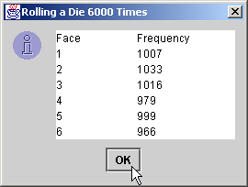
RollDie.java
35 System.exit( 0 );
36 }
37 }

Slide 22
Referencias como Parámetros
Hay dos formas de pasar argumentos a los métodos
  Pasar por valor
    Copia del valor de pasa al método
    En Java todos las primitivas se pasan por valor
  Pasar por referencia
    El método obtiene acceso directo a la data
    El método puede manipular esa data
    Mejor performance
    En Java, todo objeto se pasa por referencia
      En Java, los arrays son objectos
        Por lo tanto, se pasan por referencia

Slide 23
Pasando Arrays a los Métodos
¿Cómo?
  Especificar el nombre del array sin corchetes
    Si el array hourlyTemperatures es
    int hourlyTemperatures = new int[ 24 ];
    Se llama así:
    modifyArray( hourlyTemperatures );
    Pasa array hourlyTemperatures al método modifyArray

Slide 24
Arrays en 2D, 3D, etc.
Arrays con múltiples indices
  Tablas con filas y columnas
    Array 2D
    Declararlo así: b[2][2]
    int b[][] = { { 1, 2 }, { 3, 4 } };
      1 y 2 van a b[0][0] y b[0][1]
      3 y 4 van a b[1][0] y b[1][1]
    int b[][] = { { 1, 2 }, { 3, 4, 5 } };
      Fila 0 contiene a 1 y 2
      Fila 1 contiene a 3, 4 y 5

Slide 25
Arrays en 2D, 3D, etc. (cont.)
Más detalles
  Pueden ubicarse dinámicamente
    Array 3-por-4
    int b[][];
    b = new int[ 3 ][ 4 ];
    Cada fila puede teenr diferente número de columnas
    int b[][];
    b = new int[ 2 ][ ]; // ubica filas
    b[ 0 ] = new int[ 5 ]; // ubica fila 0
    b[ 1 ] = new int[ 3 ]; // ubica fila 1

Slide 26
Column 0
Column 1
Column 2
Column 3
Row 0
a[ 0 ][ 0 ]
a[ 1 ][ 0 ]
a[ 2 ][ 0 ]
a[ 0 ][ 1 ]
a[ 1 ][ 1 ]
a[ 2 ][ 1 ]
a[ 0 ][ 2 ]
a[ 1 ][ 2 ]
a[ 2 ][ 2 ]
a[ 0 ][ 3 ]
a[ 1 ][ 3 ]
a[ 2 ][ 3 ]
Row 1
Row 2
Column subscript (or index)
Row Subscript (or index)
Array name
A double-subscripted array with three rows and four columns.

Slide 27
InitArray.java
Line 20
Declare array1 with six initializers in two sublists
Line 21
Declare array2 with six initializers in three sublists
1 // Fig. 7.15: InitArray.java
2 // Initializing multidimensional arrays
3
4 // Java core packages
5 import java.awt.Container;
6
7 // Java extension packages
8 import javax.swing.*;
9
10 public class InitArray extends JApplet {
11 JTextArea outputArea;
12
13 // set up GUI and initialize applet
14 public void init()
15 {
16 outputArea = new JTextArea();
17 Container container = getContentPane();
18 container.add( outputArea );
19
20 int array1[][] = { { 1, 2, 3 }, { 4, 5, 6 } };
21 int array2[][] = { { 1, 2 }, { 3 }, { 4, 5, 6 } };
22
23 outputArea.setText( "Values in array1 by row are\n" );
24 buildOutput( array1 );
25
26 outputArea.append( "\nValues in array2 by row are\n" );
27 buildOutput( array2 );
28 }
29
30 // append rows and columns of an array to outputArea
31 public void buildOutput( int array[][] )
32 {
Declare array1 with six initializers in two sublists
Declare array2 with six initializers in three sublists

Slide 28
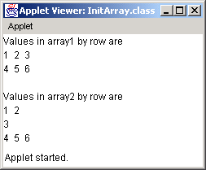
InitArray.java
Line 38 array[row].length returns number of columns associated with row subscript
Line 40
Use double-bracket notation to access double-subscripted array values
array[row].length returns number of columns associated with row subscript
33 // loop through array's rows
34 for ( int row = 0; row < array.length; row++ ) {
35
36 // loop through columns of current row
37 for ( int column = 0;
38 column < array[ row ].length;
39 column++ )
40 outputArea.append( array[ row ][ column ] + " " );
41
42 outputArea.append( "\n" );
43 }
44 }
45 }
Use double-bracket notation to access double-subscripted array values

Slide 29
Métodos
Métodos
  Permiten modularizar los programas
    El desarrollo de software es más manejable
    Resuabilidad del Software
    Evita repetir código fuente
  Variables locales
    Declaradas en la definición del método
  Parameters
    Comunican información entre métodos mediante llamadas

Slide 30
Definiendo métodos
Los prograamdores pueden escribir métodos customizados

Slide 31
SquareIntegers.java
Line 24
Declare result to store square of number
Line 31
Method init invokes method square
Line 31
Method square returns int that result stores
1 // Fig. 6.3: SquareIntegers.java
2 // A programmer-defined square method
3
4 // Java core packages
5 import java.awt.Container;
6
7 // Java extension packages
8 import javax.swing.*;
9
10 public class SquareIntegers extends JApplet {
11
12 // set up GUI and calculate squares of integers from 1 to 10
13 public void init()
14 {
15 // JTextArea to display results
16 JTextArea outputArea = new JTextArea();
17
18 // get applet's content pane (GUI component display area)
19 Container container = getContentPane();
20
21 // attach outputArea to container
22 container.add( outputArea );
23
24 int result; // store result of call to method square
25 String output = ""; // String containing results
26
27 // loop 10 times
28 for ( int counter = 1; counter <= 10; counter++ ) {
29
30 // calculate square of counter and store in result
31 result = square( counter );
32
33 // append result to String output
34 output += "The square of " + counter +
35 " is " + result + "\n";
Declare result to store square of number
Method init invokes method square (next slide)
Method square returns int that result stores

Slide 32
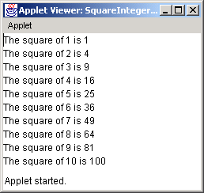
SquareIntegers.java
Line 44 y is the parameter of method square
Line 46
Method square returns the square of y
36
37 } // end for structure
38
39 outputArea.setText( output ); // place results in JTextArea
40
41 } // end method init
42
43 // square method definition
44 public int square( int y )
45 {
46 return y * y; // return square of y
47
48 } // end method square
49
50 } // end class SquareIntegers
y is the parameter of method square
Method square returns the square of y

Slide 33
Definiendo métodos (cont.)
Formato geenral:
tipo-de-retorno nombre-método( lista-parámetros )
{
declaraciones y comandos
}
Método puede retornar (return) valores:
return expresión;

Slide 34
Maximum.java
Lines 16-21
User inputs three Strings
Lines 24-26
Convert Strings to doubles
Line 29
Method init passes doubles as arguments to method maximum
1 // Fig. 6.4: Maximum.java
2 // Finding the maximum of three doubles
3
4 // Java core packages
5 import java.awt.Container;
6
7 // Java extension packages
8 import javax.swing.*;
9
10 public class Maximum extends JApplet {
11
12 // initialize applet by obtaining user input and creating GUI
13 public void init()
14 {
15 // obtain user input
16 String s1 = JOptionPane.showInputDialog(
17 "Enter first floating-point value" );
18 String s2 = JOptionPane.showInputDialog(
19 "Enter second floating-point value" );
20 String s3 = JOptionPane.showInputDialog(
21 "Enter third floating-point value" );
22
23 // convert user input to double values
24 double number1 = Double.parseDouble( s1 );
25 double number2 = Double.parseDouble( s2 );
26 double number3 = Double.parseDouble( s3 );
27
28 // call method maximum to determine largest value
29 double max = maximum( number1, number2, number3 );
30
31 // create JTextArea to display results
32 JTextArea outputArea = new JTextArea();
33
User inputs three Strings
Convert Strings to doubles
Method init passes doubles as arguments to method maximum

Slide 35
Maximum.java
Line 51
Method maximum returns value from method max of class Math
34 // display numbers and maximum value
35 outputArea.setText( "number1: " + number1 +
36 "\nnumber2: " + number2 + "\nnumber3: " + number3 +
37 "\nmaximum is: " + max );
38
39 // get the applet's GUI component display area
40 Container container = getContentPane();
41
42 // attach outputArea to Container c
43 container.add( outputArea );
44
45 } // end method init
46
47 // maximum method uses Math class method max to help
48 // determine maximum value
49 public double maximum( double x, double y, double z )
50 {
51 return Math.max( x, Math.max( y, z ) );
52
53 } // end method maximum
54
55 } // end class Maximum
Method maximum returns value from method max of class Math

Slide 36
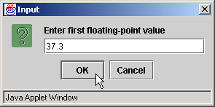
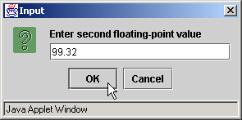
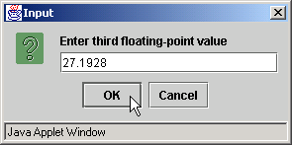
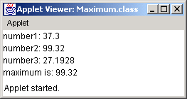
Maximum.java

Slide 37
Promoción de argumentos
Coerción de argumentos
  Forzar paso de argumentos del tipo apropiado al método
    Ej.: System.out.println( Math.sqrt( 4 ) );
      Evalua Math.sqrt( 4 )
      Luego evalua System.out.println()
Reglas de promoción
  Especifican como convertir tipos sin pérdida de información

Slide 38
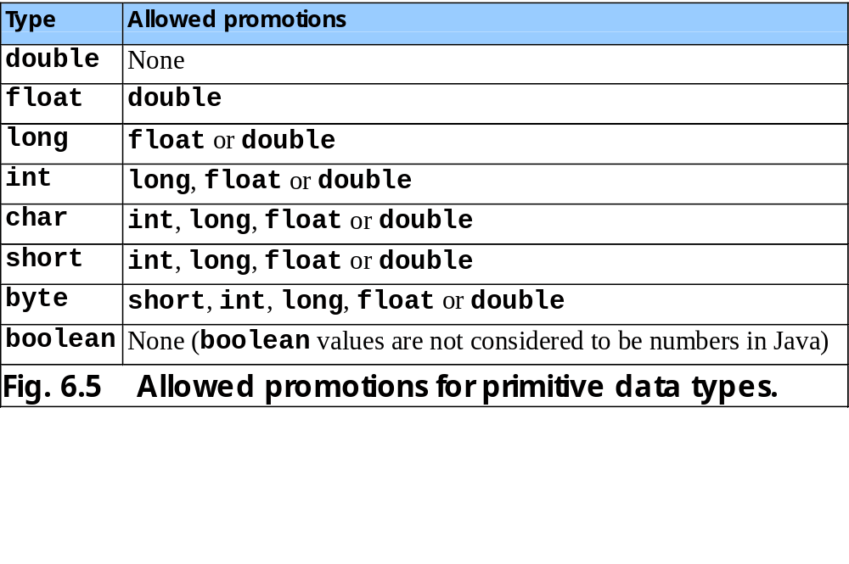

Slide 39
Sobrecarga de métodos
Sobrecarga
  Varios métodos con el mismo nombre
  Pero con diferente conjunto de parámetros para cada método
    Número de parámetros
    Tipos de los parámetros

Slide 40
MethodOverload.java
Lines 25-32
Method square receives an int as an argument
1 // Fig. 6.16: MethodOverload.java
2 // Using overloaded methods
3
4 // Java core packages
5 import java.awt.Container;
6
7 // Java extension packages
8 import javax.swing.*;
9
10 public class MethodOverload extends JApplet {
11
12 // set up GUI and call versions of method square
13 public void init()
14 {
15 JTextArea outputArea = new JTextArea();
16 Container container = getContentPane();
17 container.add( outputArea );
18
19 outputArea.setText(
20 "The square of integer 7 is " + square( 7 ) +
21 "\nThe square of double 7.5 is " + square( 7.5 ) );
22 }
23
24 // square method with int argument
25 public int square( int intValue )
26 {
27 System.out.println(
28 "Called square with int argument: " + intValue );
29
30 return intValue * intValue;
31
32 } // end method square with int argument
33
Method square receives an int as an argument

Slide 41
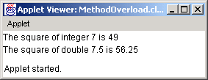
MethodOverload.java
Lines 35-42
Overloaded method square receives a double as an argument
34 // square method with double argument
35 public double square( double doubleValue )
36 {
37 System.out.println(
38 "Called square with double argument: " + doubleValue );
39
40 return doubleValue * doubleValue;
41
42 } // end method square with double argument
43
44 } // end class MethodOverload
Overloaded method square receives a double as an argument
Called square with int argument: 7
Called square with double argument: 7.5

Slide 42
MethodOverload.java
Lines 11 and 18
Compiler cannot distinguish between methods with identical names and parameter sets
Fig. 6.17 Compiler error messages generated from overloaded methods with identical parameter lists and different return types.
1 // Fig. 6.17: MethodOverload.java
2 // Overloaded methods with identical signatures and
3 // different return types.
4
5 // Java extension packages
6 import javax.swing.JApplet;
7
8 public class MethodOverload extends JApplet {
9
10 // first definition of method square with double argument
11 public int square( double x )
12 {
13 return x * x;
14 }
15
16 // second definition of method square with double argument
17 // causes syntax error
18 public double square( double y )
19 {
20 return y * y;
21 }
22
23 } // end class MethodOverload
Compiler cannot distinguish between methods with identical names and parameter sets
MethodOverload.java:18: square(double) is already defined in
MethodOverload
public double square( double y )
^
MethodOverload.java:13: possible loss of precision
found : double
required: int
return x * x;
^
2 errors

Slide 43
POO (OOP)
Programación Orientada a Objetos
Object Oriented Programming (OOP)
  Encapsula data (atributos) y métodos (comportamientos)
    Objetos
  Permite que los objetos se comuniquen
    Interfaces bien definidas

Slide 44
POO (cont.)
Lenguajes procedurales
  Ejemplo: C
  Orientados a la acción
  Las unidades básicas del programa son las fucniones
Lenguajes OO
  Ej.:Java
  Orientados a objetos
  Las unidades básicas son las clases
    Las funciones (métodos), están encapsuladas dentro de clases

Slide 45
POO (cont.)
Veremos
  Cómo crear objetos?
  Cómo usarlos?

Slide 46
Implementando clases
Ejemplos: Time1 y TimeTest
  Time1.java define la clase Time1
  TimeTest.java define la clase TimeTest
  Clases public deben definirse en archivos separados
  Clase Time1 no se ejecuta por si misma
    No tiene método main
    Y no es un dreivado de JApplet
    TimeTest, que si tiene método main, crea (instancia) y usa un objeto Time1

Slide 47
Time1.java
Line 7
Time1 (subclass) inherits superclass java.lang.Object
Lines 8-10 private variables
Lines 15, 22 and 30 public methods
Lines 15-18
Time1 constructor then invokes method setTime
Lines 22-27
Method setTime sets private variables according to arguments
1 // Fig. 8.1: Time1.java
2 // Time1 class definition maintains the time in 24-hour format.
3
4 // Java core packages
5 import java.text.DecimalFormat;
6
7 public class Time1 extends Object {
8 private int hour; // 0 - 23
9 private int minute; // 0 - 59
10 private int second; // 0 - 59
11
12 // Time1 constructor initializes each instance variable
13 // to zero. Ensures that each Time1 object starts in a
14 // consistent state.
15 public Time1()
16 {
17 setTime( 0, 0, 0 );
18 }
19
20 // Set a new time value using universal time. Perform
21 // validity checks on the data. Set invalid values to zero.
22 public void setTime( int h, int m, int s )
23 {
24 hour = ( ( h >= 0 && h < 24 ) ? h : 0 );
25 minute = ( ( m >= 0 && m < 60 ) ? m : 0 );
26 second = ( ( s >= 0 && s < 60 ) ? s : 0 );
27 }
28
29 // convert to String in universal-time format
30 public String toUniversalString()
31 {
32 DecimalFormat twoDigits = new DecimalFormat( "00" );
33
Time1 (subclass) inherits superclass java.lang.Object (Chapter 9 discusses inheritance)
private variables (and methods) are accessible only to methods in this class
public methods (and variables) are accessible wherever program has Time1 reference
Time1 constructor creates Time1 object then invokes method setTime
Method setTime sets private variables according to arguments

Slide 48
Time1.java
Line 40
Method toString is a method from java.lang.Object
Line 40
Time1 overrides this method to provide more appropriate method
34 return twoDigits.format( hour ) + ":" +
35 twoDigits.format( minute ) + ":" +
36 twoDigits.format( second );
37 }
38
39 // convert to String in standard-time format
40 public String toString()
41 {
42 DecimalFormat twoDigits = new DecimalFormat( "00" );
43
44 return ( (hour == 12 || hour == 0) ? 12 : hour % 12 ) +
45 ":" + twoDigits.format( minute ) +
46 ":" + twoDigits.format( second ) +
47 ( hour < 12 ? " AM" : " PM" );
48 }
49
50 } // end class Time1
Method toString is a method from java.lang.Object
Time1 overrides this method to provide more appropriate method

Slide 49
Implementando clases (cont.)
Cada clase Java debe extender otra clase
  Time1 extendiende java.lang.Object
  Si una clse no “extend” explicitamente otra clase
    Implicitamente extiende Object
Constructor de una clase
  Método con el mismo nombre que la clase
  Inicializa las variables de la clase
  Se llama cuando el programa instancia un objeto de esa clase
  Puede tomar argumentos, pero no hace return
  Una clase puede tener varios constructores, usando sobrecarga
  Clase Time1 (lineas 15-18)

Slide 50
Implementando clases (cont.)
Override
  Método Object.toString
    Crea una representación String de un objeto
    Queremos que de un String en formato hh:mm:ss
  Time1 hace override de toString (lineas 40-48)
    Si removemos esas lineas
      Time1 compila y corre
      Use el método java.lang.Object.toString
      Da la representación String de un objeto

Slide 51
TimeTest1.java
Line 12
Declare and initialize instance of class Time1 by calling Time1 constructor
Lines 16-31 TimeTest interacts with Time1 by calling Time1 public methods
1 // Fig. 8.2: TimeTest1.java
2 // Class TimeTest1 to exercise class Time1
3
4 // Java extension packages
5 import javax.swing.JOptionPane;
6
7 public class TimeTest1 {
8
9 // create Time1 object and manipulate it
10 public static void main( String args[] )
11 {
12 Time1 time = new Time1(); // calls Time1 constructor
13
14 // append String version of time to String output
15 String output = "The initial universal time is: " +
16 time.toUniversalString() +
17 "\nThe initial standard time is: " + time.toString() +
18 "\nImplicit toString() call: " + time;
19
20 // change time and append String version of time to output
21 time.setTime( 13, 27, 6 );
22 output += "\n\nUniversal time after setTime is: " +
23 time.toUniversalString() +
24 "\nStandard time after setTime is: " + time.toString();
25
26 // use invalid values to change time and append String
27 // version of time to output
28 time.setTime( 99, 99, 99 );
29 output += "\n\nAfter attempting invalid settings: " +
30 "\nUniversal time: " + time.toUniversalString() +
31 "\nStandard time: " + time.toString();
32
33 JOptionPane.showMessageDialog( null, output,
34 "Testing Class Time1",
35 JOptionPane.INFORMATION_MESSAGE );
Declare and initialize instance of class Time1 by calling Time1 constructor
TimeTest interacts with Time1 by calling Time1 public methods

Slide 52
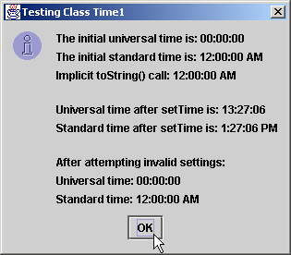
TimeTest1.java
36
37 System.exit( 0 );
38 }
39
40 } // end class TimeTest1

Slide 53
Alcance de una clase
Alcance de una clase
  De los atributos y métodos de una instacia de la clase
  Son accesibles a todos los métodos de la misma clase
  Se les puede llamar directamente por su nombre
Alcance de bloque
  Variables definidas dentro de un método
    Solo existen en ese método

Slide 54
Control de Acceso de miembros (atributos, métodos.)
Modificadores de acceso
  Controla acceso a las variables y métodos
  public
    Variables y métodos accesibles a otras clases
  private
    Variables y métodos no accesibles a otras clases
    Método de acceso lectura (“get”)
      Para que otras clases puedan leer data private
    Método de acceso escritura (“set”)
      Para que otras clases puedan modificar data private

Slide 55
TimeTest2.java
Line 10
Compiler error – TimeTest2 cannot directly access Time1’s private data
Fig. 8.3 Erroneous attempt to access private members of class Time1.
1 // Fig. 8.3: TimeTest2.java
2 // Demonstrate errors resulting from attempts
3 // to access private members of class Time1.
4 public class TimeTest2 {
5
6 public static void main( String args[] )
7 {
8 Time1 time = new Time1();
9
10 time.hour = 7;
11 }
12 }
Compiler error – TimeTest2 cannot directly access Time1’s private data
TimeTest2.java:10: hour has private access in Time1
time.hour = 7;
^
1 error

Slide 56
Creando Paquetes
Hacer import de paquetes en programas
  Paquete: grupo de clase e interfaces relacionadas
  Ayudan a manejar la complejidad de los componentes
  Facilitan reuso de software
  Proporcionan un medio para no repetir nombre de clases
    Convención de nombres
      Dominio de Internet al revés
        Ej.: .pe.com.miempresa

Slide 57
Time1.java
Line 3
Class Time1 is placed in this package
Line 3
Class Time1 is in directory com/deitel/jhtp4/ch08
Line 6 import class DecimalFormat from package java.text
Line 33
DecimalFormat from package java.text
1 // Fig. 8.4: Time1.java
2 // Time1 class definition in a package
3 package com.deitel.jhtp4.ch08;
4
5 // Java core packages
6 import java.text.DecimalFormat;
7
8 public class Time1 extends Object {
9 private int hour; // 0 - 23
10 private int minute; // 0 - 59
11 private int second; // 0 - 59
12
13 // Time1 constructor initializes each instance variable
14 // to zero. Ensures that each Time1 object starts in a
15 // consistent state.
16 public Time1()
17 {
18 setTime( 0, 0, 0 );
19 }
20
21 // Set a new time value using universal time. Perform
22 // validity checks on the data. Set invalid values to zero.
23 public void setTime( int h, int m, int s )
24 {
25 hour = ( ( h >= 0 && h < 24 ) ? h : 0 );
26 minute = ( ( m >= 0 && m < 60 ) ? m : 0 );
27 second = ( ( s >= 0 && s < 60 ) ? s : 0 );
28 }
29
30 // convert to String in universal-time format
31 public String toUniversalString()
32 {
33 DecimalFormat twoDigits = new DecimalFormat( "00" );
34
Class Time1 is placed in this package
Class Time1 is in directory com/deitel/jhtp4/ch08
import class DecimalFormat from package java.text
DecimalFormat from package java.text

Slide 58
Time1.java
35 return twoDigits.format( hour ) + ":" +
36 twoDigits.format( minute ) + ":" +
37 twoDigits.format( second );
38 }
39
40 // convert to String in standard-time format
41 public String toString()
42 {
43 DecimalFormat twoDigits = new DecimalFormat( "00" );
44
45 return ( (hour == 12 || hour == 0) ? 12 : hour % 12 ) +
46 ":" + twoDigits.format( minute ) +
47 ":" + twoDigits.format( second ) +
48 ( hour < 12 ? " AM" : " PM" );
49 }
50
51 } // end class Time1

Slide 59
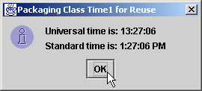
TimeTest3.java
Line 5 import class JOptionPane from package javax.swing
Line 8 import class Time1 from package com.deitel.jhtp4.ch08
Line 15
TimeTest3 can declare Time1 object
1 // Fig. 8.5: TimeTest3.java
2 // Class TimeTest3 to use imported class Time1
3
4 // Java extension packages
5 import javax.swing.JOptionPane;
6
7 // Deitel packages
8 import com.deitel.jhtp4.ch08.Time1; // import Time1 class
9
10 public class TimeTest3 {
11
12 // create an object of class Time1 and manipulate it
13 public static void main( String args[] )
14 {
15 Time1 time = new Time1(); // create Time1 object
16
17 time.setTime( 13, 27, 06 ); // set new time
18 String output =
19 "Universal time is: " + time.toUniversalString() +
20 "\nStandard time is: " + time.toString();
21
22 JOptionPane.showMessageDialog( null, output,
23 "Packaging Class Time1 for Reuse",
24 JOptionPane.INFORMATION_MESSAGE );
25
26 System.exit( 0 );
27 }
28
29 } // end class TimeTest3
import class JOptionPane from package javax.swing
import class Time1 from package com.deitel.jhtp4.ch08
TimeTest3 can declare Time1 object

Slide 60
Inicializando Objetos: Constructores
Constructor
  Mismo nombre que la clase
  Inicializa los atributos del objeto
  Se suele llamar al constructor para instanciar un objeto de una clase
    ref = new NombreClase( argumentos );
    ref es una referencia apropiada
    new indica que se crea un nuevo objeto
    NombreClase indica el tipo de objeto creado
    argumentos son los parámetros del constructor

Slide 61
Usando Constructores sobrecargados
Más de un constructor
  Métodos (de la misma clase) con el mismo nombre
  Pero diferente lista de parámetros

Slide 62
Time2.java
Lines 16-19
Default constructor has no arguments
Lines 23-26
Overloaded constructor has one int argument
Lines 30-33
Second overloaded constructor has two int arguments
1 // Fig. 8.6: Time2.java
2 // Time2 class definition with overloaded constructors.
3 package com.deitel.jhtp4.ch08;
4
5 // Java core packages
6 import java.text.DecimalFormat;
7
8 public class Time2 extends Object {
9 private int hour; // 0 - 23
10 private int minute; // 0 - 59
11 private int second; // 0 - 59
12
13 // Time2 constructor initializes each instance variable
14 // to zero. Ensures that Time object starts in a
15 // consistent state.
16 public Time2()
17 {
18 setTime( 0, 0, 0 );
19 }
20
21 // Time2 constructor: hour supplied, minute and second
22 // defaulted to 0
23 public Time2( int h )
24 {
25 setTime( h, 0, 0 );
26 }
27
28 // Time2 constructor: hour and minute supplied, second
29 // defaulted to 0
30 public Time2( int h, int m )
31 {
32 setTime( h, m, 0 );
33 }
34
Default constructor has no arguments
Overloaded constructor has one int argument
Second overloaded constructor has two int arguments

Slide 63
Time2.java
Lines 36-39
Third overloaded constructor has three int arguments
Lines 42-45
Fourth overloaded constructor has Time2 argument
35 // Time2 constructor: hour, minute and second supplied
36 public Time2( int h, int m, int s )
37 {
38 setTime( h, m, s );
39 }
40
41 // Time2 constructor: another Time2 object supplied
42 public Time2( Time2 time )
43 {
44 setTime( time.hour, time.minute, time.second );
45 }
46
47 // Set a new time value using universal time. Perform
48 // validity checks on data. Set invalid values to zero.
49 public void setTime( int h, int m, int s )
50 {
51 hour = ( ( h >= 0 && h < 24 ) ? h : 0 );
52 minute = ( ( m >= 0 && m < 60 ) ? m : 0 );
53 second = ( ( s >= 0 && s < 60 ) ? s : 0 );
54 }
55
56 // convert to String in universal-time format
57 public String toUniversalString()
58 {
59 DecimalFormat twoDigits = new DecimalFormat( "00" );
60
61 return twoDigits.format( hour ) + ":" +
62 twoDigits.format( minute ) + ":" +
63 twoDigits.format( second );
64 }
65
66 // convert to String in standard-time format
67 public String toString()
68 {
69 DecimalFormat twoDigits = new DecimalFormat( "00" );
Third overloaded constructor has three int arguments
Fourth overloaded constructor has Time2 argument

Slide 64
Time2.java
70
71 return ( (hour == 12 || hour == 0) ? 12 : hour % 12 ) +
72 ":" + twoDigits.format( minute ) +
73 ":" + twoDigits.format( second ) +
74 ( hour < 12 ? " AM" : " PM" );
75 }
76
77 } // end class Time2

Slide 65
TimeTest4.java
Line 15
Declare six references to Time2 objects
Lines 17-22
Instantiate each Time2 reference using a different constructor
1 // Fig. 8.7: TimeTest4.java
2 // Using overloaded constructors
3
4 // Java extension packages
5 import javax.swing.*;
6
7 // Deitel packages
8 import com.deitel.jhtp4.ch08.Time2;
9
10 public class TimeTest4 {
11
12 // test constructors of class Time2
13 public static void main( String args[] )
14 {
15 Time2 t1, t2, t3, t4, t5, t6;
16
17 t1 = new Time2(); // 00:00:00
18 t2 = new Time2( 2 ); // 02:00:00
19 t3 = new Time2( 21, 34 ); // 21:34:00
20 t4 = new Time2( 12, 25, 42 ); // 12:25:42
21 t5 = new Time2( 27, 74, 99 ); // 00:00:00
22 t6 = new Time2( t4 ); // 12:25:42
23
24 String output = "Constructed with: " +
25 "\nt1: all arguments defaulted" +
26 "\n " + t1.toUniversalString() +
27 "\n " + t1.toString();
28
29 output += "\nt2: hour specified; minute and " +
30 "second defaulted" +
31 "\n " + t2.toUniversalString() +
32 "\n " + t2.toString();
33
Declare six references to Time2 objects
Instantiate each Time2 reference using a different constructor

Slide 66
TimeTest4.java
34 output += "\nt3: hour and minute specified; " +
35 "second defaulted" +
36 "\n " + t3.toUniversalString() +
37 "\n " + t3.toString();
38
39 output += "\nt4: hour, minute, and second specified" +
40 "\n " + t4.toUniversalString() +
41 "\n " + t4.toString();
42
43 output += "\nt5: all invalid values specified" +
44 "\n " + t5.toUniversalString() +
45 "\n " + t5.toString();
46
47 output += "\nt6: Time2 object t4 specified" +
48 "\n " + t6.toUniversalString() +
49 "\n " + t6.toString();
50
51 JOptionPane.showMessageDialog( null, output,
52 "Demonstrating Overloaded Constructors",
53 JOptionPane.INFORMATION_MESSAGE );
54
55 System.exit( 0 );
56 }
57
58 } // end class TimeTest4

Slide 67
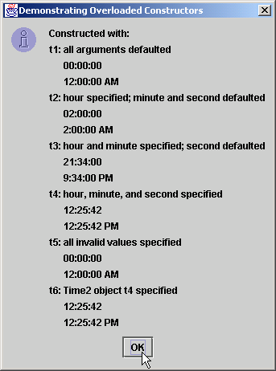
TimeTest4.java
Different outputs, because each Time2 reference was instantiated with a different constructor
Different outputs, because each Time2 reference was instantiated with a different constructor

Slide 68
Usando Métodos Set y Get
Leer: “get”
  public
  Permite leer data private
Escribir: “set”
  public
  Permite modificar data private

Slide 69
Time3.java
Lines 9-11 private variables cannot be accessed directly by objects in different classes
1 // Fig. 8.8: Time3.java
2 // Time3 class definition with set and get methods
3 package com.deitel.jhtp4.ch08;
4
5 // Java core packages
6 import java.text.DecimalFormat;
7
8 public class Time3 extends Object {
9 private int hour; // 0 - 23
10 private int minute; // 0 - 59
11 private int second; // 0 - 59
12
13 // Time3 constructor initializes each instance variable
14 // to zero. Ensures that Time object starts in a
15 // consistent state.
16 public Time3()
17 {
18 setTime( 0, 0, 0 );
19 }
20
21 // Time3 constructor: hour supplied, minute and second
22 // defaulted to 0
23 public Time3( int h )
24 {
25 setTime( h, 0, 0 );
26 }
27
28 // Time3 constructor: hour and minute supplied, second
29 // defaulted to 0
30 public Time3( int h, int m )
31 {
32 setTime( h, m, 0 );
33 }
34
private variables cannot be accessed directly by objects in different classes

Slide 70
Time3.java
Lines 51-68
Mutator methods allows objects to manipulate private variables
35 // Time3 constructor: hour, minute and second supplied
36 public Time3( int h, int m, int s )
37 {
38 setTime( h, m, s );
39 }
40
41 // Time3 constructor: another Time3 object supplied
42 public Time3( Time3 time )
43 {
44 setTime( time.getHour(), time.getMinute(),
45 time.getSecond() );
46 }
47
48 // Set Methods
49 // Set a new time value using universal time. Perform
50 // validity checks on data. Set invalid values to zero.
51 public void setTime( int h, int m, int s )
52 {
53 setHour( h ); // set the hour
54 setMinute( m ); // set the minute
55 setSecond( s ); // set the second
56 }
57
58 // validate and set hour
59 public void setHour( int h )
60 {
61 hour = ( ( h >= 0 && h < 24 ) ? h : 0 );
62 }
63
64 // validate and set minute
65 public void setMinute( int m )
66 {
67 minute = ( ( m >= 0 && m < 60 ) ? m : 0 );
68 }
69
Mutator methods allows objects to manipulate private variables

Slide 71
Time3.java
Lines 78-93
Accessor methods allows objects to read private variables
70 // validate and set second
71 public void setSecond( int s )
72 {
73 second = ( ( s >= 0 && s < 60 ) ? s : 0 );
74 }
75
76 // Get Methods
77 // get hour value
78 public int getHour()
79 {
80 return hour;
81 }
82
83 // get minute value
84 public int getMinute()
85 {
86 return minute;
87 }
88
89 // get second value
90 public int getSecond()
91 {
92 return second;
93 }
94
95 // convert to String in universal-time format
96 public String toUniversalString()
97 {
98 DecimalFormat twoDigits = new DecimalFormat( "00" );
99
100 return twoDigits.format( getHour() ) + ":" +
101 twoDigits.format( getMinute() ) + ":" +
102 twoDigits.format( getSecond() );
103 }
104
Accessor methods allows objects to read private variables

Slide 72
Time3.java
105 // convert to String in standard-time format
106 public String toString()
107 {
108 DecimalFormat twoDigits = new DecimalFormat( "00" );
109
110 return ( ( getHour() == 12 || getHour() == 0 ) ?
111 12 : getHour() % 12 ) + ":" +
112 twoDigits.format( getMinute() ) + ":" +
113 twoDigits.format( getSecond() ) +
114 ( getHour() < 12 ? " AM" : " PM" );
115 }
116
117 } // end class Time3

Slide 73
TimeTest5.java
Lines 17 and 26
Declare and instantiate Time3 object
1 // Fig. 8.9: TimeTest5.java
2 // Demonstrating the Time3 class set and get methods.
3
4 // Java core packages
5 import java.awt.*;
6 import java.awt.event.*;
7
8 // Java extension packages
9 import javax.swing.*;
10
11 // Deitel packages
12 import com.deitel.jhtp4.ch08.Time3;
13
14 public class TimeTest5 extends JApplet
15 implements ActionListener {
16
17 private Time3 time;
18 private JLabel hourLabel, minuteLabel, secondLabel;
19 private JTextField hourField, minuteField,
20 secondField, displayField;
21 private JButton tickButton;
22
23 // Create Time3 object and set up GUI
24 public void init()
25 {
26 time = new Time3();
27
28 Container container = getContentPane();
29 container.setLayout( new FlowLayout() );
30
31 // set up hourLabel and hourField
32 hourLabel = new JLabel( "Set Hour" );
33 hourField = new JTextField( 10 );
34 hourField.addActionListener( this );
Declare and instantiate Time3 object

Slide 74
TimeTest5.java
Lines 39-55 JTextFields allow user to specify time
35 container.add( hourLabel );
36 container.add( hourField );
37
38 // set up minuteLabel and minuteField
39 minuteLabel = new JLabel( "Set minute" );
40 minuteField = new JTextField( 10 );
41 minuteField.addActionListener( this );
42 container.add( minuteLabel );
43 container.add( minuteField );
44
45 // set up secondLabel and secondField
46 secondLabel = new JLabel( "Set Second" );
47 secondField = new JTextField( 10 );
48 secondField.addActionListener( this );
49 container.add( secondLabel );
50 container.add( secondField );
51
52 // set up displayField
53 displayField = new JTextField( 30 );
54 displayField.setEditable( false );
55 container.add( displayField );
56
57 // set up tickButton
58 tickButton = new JButton( "Add 1 to Second" );
59 tickButton.addActionListener( this );
60 container.add( tickButton );
61
62 updateDisplay(); // update text in displayField
63 }
64
65 // handle button and text field events
66 public void actionPerformed( ActionEvent actionEvent )
67 {
JTextFields allow user to specify time

Slide 75
TimeTest5.java
Lines 74-76
Lines 81-83
Lines 88-90 TimeTest5 uses Time3 mutator methods to set Time3 private variables
68 // process tickButton event
69 if ( actionEvent.getSource() == tickButton )
70 tick();
71
72 // process hourField event
73 else if ( actionEvent.getSource() == hourField ) {
74 time.setHour(
75 Integer.parseInt( actionEvent.getActionCommand() ) );
76 hourField.setText( "" );
77 }
78
79 // process minuteField event
80 else if ( actionEvent.getSource() == minuteField ) {
81 time.setMinute(
82 Integer.parseInt( actionEvent.getActionCommand() ) );
83 minuteField.setText( "" );
84 }
85
86 // process secondField event
87 else if ( actionEvent.getSource() == secondField ) {
88 time.setSecond(
89 Integer.parseInt( actionEvent.getActionCommand() ) );
90 secondField.setText( "" );
91 }
92
93 updateDisplay(); // update displayField and status bar
94 }
95
96 // update displayField and applet container's status bar
97 public void updateDisplay()
98 {
99 displayField.setText( "Hour: " + time.getHour() +
100 "; Minute: " + time.getMinute() +
101 "; Second: " + time.getSecond() );
102
TimeTest5 uses Time3 mutator methods to set Time3 private variables

Slide 76
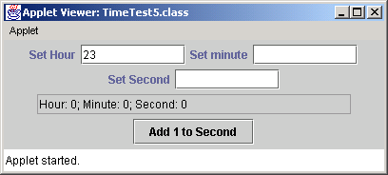
TimeTest5.java
Lines 110-116 TimeTest5 uses Time3 accessor methods to read Time3 private variables
103 showStatus( "Standard time is: " + time.toString() +
104 "; Universal time is: " + time.toUniversalString() );
105 }
106
107 // add one to second and update hour/minute if necessary
108 public void tick()
109 {
110 time.setSecond( ( time.getSecond() + 1 ) % 60 );
111
112 if ( time.getSecond() == 0 ) {
113 time.setMinute( ( time.getMinute() + 1 ) % 60 );
114
115 if ( time.getMinute() == 0 )
116 time.setHour( ( time.getHour() + 1 ) % 24 );
117 }
118 }
119
120 } // end class TimeTest5
TimeTest5 uses Time3 accessor methods to read Time3 private variables

Slide 77
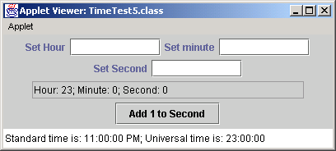
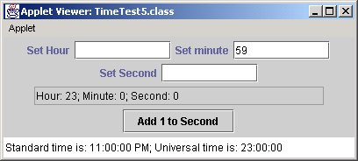

TimeTest5.java

Slide 78
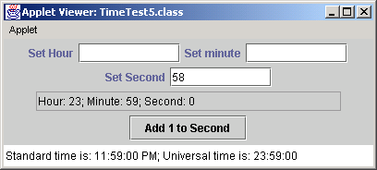

TimeTest5.java

Slide 79


TimeTest5.java

Slide 80
Reusabilida de Software
Java
  Framework para lograr reusabilidade
  Desarrollo rápido de aplicaciones. Rapid applications development (RAD)
    Ej. crear una GUI rápidamente

Slide 81
Variables Final
final
  Indica que la variable no es modificable
    Si intentas modificar una variable final sale error
  private final int INCREMENT = 5;
    Declara que la variable INCREMENT es constante
  Fuerza el principio de menor privilegio

Slide 82
Increment.java
Line 15 final keyword declares INCREMENT as constant
Line 32 final variable INCREMENT must be initialized before using it
1 // Fig. 8.11: Increment.java
2 // Initializing a final variable
3
4 // Java core packages
5 import java.awt.*;
6 import java.awt.event.*;
7
8 // Java extension packages
9 import javax.swing.*;
10
11 public class Increment extends JApplet
12 implements ActionListener {
13
14 private int count = 0, total = 0;
15 private final int INCREMENT = 5; // constant variable
16
17 private JButton button;
18
19 // set up GUI
20 public void init()
21 {
22 Container container = getContentPane();
23
24 button = new JButton( "Click to increment" );
25 button.addActionListener( this );
26 container.add( button );
27 }
28
29 // add INCREMENT to total when user clicks button
30 public void actionPerformed( ActionEvent actionEvent )
31 {
32 total += INCREMENT;
33 count++;
34 showStatus( "After increment " + count +
35 ": total = " + total );
final keyword declares INCREMENT as constant
final variable INCREMENT must be initialized before using it

Slide 83
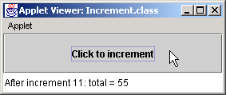
Increment.java
Compiler error message as a result of not initializing increment.
36 }
37
38 } // end class Increment
Increment.java:11: variable INCREMENT might not have been initialized
public class Increment extends Japplet
^
1 error

Slide 84
Composición: Objetos como variables de otras clases
Composición
  Clase contiene referencias a objetos de otras clases
    Son atributos de esa clase

Slide 85
Date.java
Line 5
Class Date encapsulates data that describes date
Lines 13-28
Date constructor instantiates Date object based on specified arguments
1 // Fig. 8.13: Date.java
2 // Declaration of the Date class.
3 package com.deitel.jhtp4.ch08;
4
5 public class Date extends Object {
6 private int month; // 1-12
7 private int day; // 1-31 based on month
8 private int year; // any year
9
10 // Constructor: Confirm proper value for month;
11 // call method checkDay to confirm proper
12 // value for day.
13 public Date( int theMonth, int theDay, int theYear )
14 {
15 if ( theMonth > 0 && theMonth <= 12 ) // validate month
16 month = theMonth;
17 else {
18 month = 1;
19 System.out.println( "Month " + theMonth +
20 " invalid. Set to month 1." );
21 }
22
23 year = theYear; // could validate year
24 day = checkDay( theDay ); // validate day
25
26 System.out.println(
27 "Date object constructor for date " + toString() );
28 }
29
30 // Utility method to confirm proper day value
31 // based on month and year.
32 private int checkDay( int testDay )
33 {
34 int daysPerMonth[] =
35 { 0, 31, 28, 31, 30, 31, 30, 31, 31, 30, 31, 30, 31 };
Class Date encapsulates data that describes date
Date constructor instantiates Date object based on specified arguments

Slide 86
Date.java
36
37 // check if day in range for month
38 if ( testDay > 0 && testDay <= daysPerMonth[ month ] )
39 return testDay;
40
41 // check for leap year
42 if ( month == 2 && testDay == 29 &&
43 ( year % 400 == 0 ||
44 ( year % 4 == 0 && year % 100 != 0 ) ) )
45 return testDay;
46
47 System.out.println( "Day " + testDay +
48 " invalid. Set to day 1." );
49
50 return 1; // leave object in consistent state
51 }
52
53 // Create a String of the form month/day/year
54 public String toString()
55 {
56 return month + "/" + day + "/" + year;
57 }
58
59 } // end class Date

Slide 87
Employee.java
Lines 9-10
Employee is composed of two references to Date objects
Lines 18-19 instantiate Date objects by calling constructors
1 // Fig. 8.14: Employee.java
2 // Definition of class Employee.
3 package com.deitel.jhtp4.ch08;
4
5 public class Employee extends Object {
6 private String firstName;
7 private String lastName;
8 private Date birthDate;
9 private Date hireDate;
10
11 // constructor to initialize name, birth date and hire date
12 public Employee( String first, String last,
13 int birthMonth, int birthDay, int birthYear,
14 int hireMonth, int hireDay, int hireYear )
15 {
16 firstName = first;
17 lastName = last;
18 birthDate = new Date( birthMonth, birthDay, birthYear );
19 hireDate = new Date( hireMonth, hireDay, hireYear );
20 }
21
22 // convert Employee to String format
23 public String toString()
24 {
25 return lastName + ", " + firstName +
26 " Hired: " + hireDate.toString() +
27 " Birthday: " + birthDate.toString();
28 }
29
30 } // end class Employee
Employee is composed of two references to Date objects
instantiate Date objects by calling constructors

Slide 88
EmployeeTest.java
1 // Fig. 8.15: EmployeeTest.java
2 // Demonstrating an object with a member object.
3
4 // Java extension packages
5 import javax.swing.JOptionPane;
6
7 // Deitel packages
8 import com.deitel.jhtp4.ch08.Employee;
9
10 public class EmployeeTest {
11
12 // test class Employee
13 public static void main( String args[] )
14 {
15 Employee employee = new Employee( "Bob", "Jones",
16 7, 24, 49, 3, 12, 88 );
17
18 JOptionPane.showMessageDialog( null,
19 employee.toString(), "Testing Class Employee",
20 JOptionPane.INFORMATION_MESSAGE );
21
22 System.exit( 0 );
23 }
24
25 } // end class EmployeeTest

Slide 89
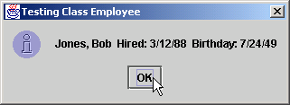
EmployeeTest.java
Date object constructor for date 7/24/1949
Date object constructor for date 3/12/1988

Slide 90
Acceso Package
Acceso al paquete
  Variable o método no tiene ninguna modificar. Es implicito.
  Puede ser accesado directamente por clases del mismo maquete

Slide 91
PackageDataTest.java
Line 13
Instantiate reference to PackageData object
Lines 17-25 PackageDataTest can access PackageData data, because each class shares same package
1 // Fig. 8.16: PackageDataTest.java
2 // Classes in the same package (i.e., the same directory) can
3 // use package access data of other classes in the same package.
4
5 // Java extension packages
6 import javax.swing.JOptionPane;
7
8 public class PackageDataTest {
9
10 // Java extension packages
11 public static void main( String args[] )
12 {
13 PackageData packageData = new PackageData();
14
15 // append String representation of packageData to output
16 String output =
17 "After instantiation:\n" + packageData.toString();
18
19 // change package access data in packageData object
20 packageData.number = 77;
21 packageData.string = "Good bye";
22
23 // append String representation of packageData to output
24 output += "\nAfter changing values:\n" +
25 packageData.toString();
26
27 JOptionPane.showMessageDialog( null, output,
28 "Demonstrating Package Access",
29 JOptionPane.INFORMATION_MESSAGE );
30
31 System.exit( 0 );
32 }
33
34 } // end class PackageDataTest
35
Instantiate reference to PackageData object
PackageDataTest can access PackageData data, because each class shares same package

Slide 92
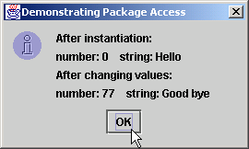
PackageDataTest.java
Line 37
No access modifier, so class has package-access variables
36 // class with package-access instance variables
37 class PackageData {
38 int number; // package-access instance variable
39 String string; // package-access instance variable
40
41 // constructor
42 public PackageData()
43 {
44 number = 0;
45 string = "Hello";
46 }
47
48 // convert PackageData object to String representation
49 public String toString()
50 {
51 return "number: " + number + " string: " + string;
52 }
53
54 } // end class PackageData
No access modifier, so class has package-access variables

Slide 93
Referencia this
This es una especie de auto-puntero
  Permite que un objeto se refiera a si mismo

Slide 94
ThisTest.java
1 // Fig. 8.17: ThisTest.java
2 // Using the this reference to refer to
3 // instance variables and methods.
4
5 // Java core packages
6 import java.text.DecimalFormat;
7
8 // Java extension packages
9 import javax.swing.*;
10
11 public class ThisTest {
12
13 // test class SimpleTime
14 public static void main( String args[] )
15 {
16 SimpleTime time = new SimpleTime( 12, 30, 19 );
17
18 JOptionPane.showMessageDialog( null, time.buildString(),
19 "Demonstrating the \"this\" Reference",
20 JOptionPane.INFORMATION_MESSAGE );
21
22 System.exit( 0 );
23 }
24
25 } // end class ThisTest
26
27 // class SimpleTime demonstrates the "this" reference
28 class SimpleTime {
29 private int hour, minute, second;
30

Slide 95
ThisTest.java
Lines 36-37 this used to distinguish between arguments and ThisTest variables
Lines 45, 57-59
Implicit use of this
31 // constructor uses parameter names identical to instance
32 // variable names, so "this" reference required to distinguish
33 // between instance variables and parameters
34 public SimpleTime( int hour, int minute, int second )
35 {
36 this.hour = hour; // set "this" object's hour
37 this.minute = minute; // set "this" object's minute
38 this.second = second; // set "this" object's second
39 }
40
41 // call toString explicitly via "this" reference, explicitly
42 // via implicit "this" reference, implicitly via "this"
43 public String buildString()
44 {
45 return "this.toString(): " + this.toString() +
46 "\ntoString(): " + toString() +
47 "\nthis (with implicit toString() call): " + this;
48 }
49
50 // convert SimpleTime to String format
51 public String toString()
52 {
53 DecimalFormat twoDigits = new DecimalFormat( "00" );
54
55 // "this" not required, because toString does not have
56 // local variables with same names as instance variables
57 return twoDigits.format( this.hour ) + ":" +
58 twoDigits.format( this.minute ) + ":" +
59 twoDigits.format( this.second );
60 }
61
62 } // end class SimpleTime
this used to distinguish between arguments and ThisTest variables
Implicit use of this

Slide 96
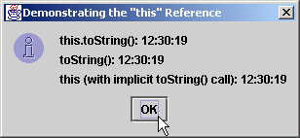
ThisTest.java

Slide 97
Time4.java
1 // Fig. 8.18: Time4.java
2 // Time4 class definition
3 package com.deitel.jhtp4.ch08;
4
5 // Java core packages
6 import java.text.DecimalFormat;
7
8 public class Time4 extends Object {
9 private int hour; // 0 - 23
10 private int minute; // 0 - 59
11 private int second; // 0 - 59
12
13 // Time4 constructor initializes each instance variable
14 // to zero. Ensures that Time object starts in a
15 // consistent state.
16 public Time4()
17 {
18 this.setTime( 0, 0, 0 );
19 }
20
21 // Time4 constructor: hour supplied, minute and second
22 // defaulted to 0
23 public Time4( int hour )
24 {
25 this.setTime( hour, 0, 0 );
26 }
27
28 // Time4 constructor: hour and minute supplied, second
29 // defaulted to 0
30 public Time4( int hour, int minute )
31 {
32 this.setTime( hour, minute, 0 );
33 }
34

Slide 98
Time4.java
Lines 56 and 64
Method returns this reference to enable chaining (concatenated method calls)
35 // Time4 constructor: hour, minute and second supplied
36 public Time4( int hour, int minute, int second )
37 {
38 this.setTime( hour, minute, second );
39 }
40
41 // Time4 constructor: another Time4 object supplied.
42 public Time4( Time4 time )
43 {
44 this.setTime( time.getHour(), time.getMinute(),
45 time.getSecond() );
46 }
47
48 // Set Methods
49 // set a new Time value using universal time
50 public Time4 setTime( int hour, int minute, int second )
51 {
52 this.setHour( hour ); // set hour
53 this.setMinute( minute ); // set minute
54 this.setSecond( second ); // set second
55
56 return this; // enables chaining
57 }
58
59 // validate and set hour
60 public Time4 setHour( int hour )
61 {
62 this.hour = ( hour >= 0 && hour < 24 ? hour : 0 );
63
64 return this; // enables chaining
65 }
66
Method returns this reference to enable chaining (concatenated method calls)

Slide 99
Time4.java
Lines 73 and 82
Method returns this reference to enable chaining (concatenated method calls)
67 // validate and set minute
68 public Time4 setMinute( int minute )
69 {
70 this.minute =
71 ( minute >= 0 && minute < 60 ) ? minute : 0;
72
73 return this; // enables chaining
74 }
75
76 // validate and set second
77 public Time4 setSecond( int second )
78 {
79 this.second =
80 ( second >= 0 && second < 60 ) ? second : 0;
81
82 return this; // enables chaining
83 }
84
85 // Get Methods
86 // get value of hour
87 public int getHour() { return this.hour; }
88
89 // get value of minute
90 public int getMinute() { return this.minute; }
91
92 // get value of second
93 public int getSecond() { return this.second; }
94
95 // convert to String in universal-time format
96 public String toUniversalString()
97 {
98 DecimalFormat twoDigits = new DecimalFormat( "00" );
99
Method returns this reference to enable chaining (concatenated method calls)

Slide 100
Time4.java
100 return twoDigits.format( this.getHour() ) + ":" +
101 twoDigits.format( this.getMinute() ) + ":" +
102 twoDigits.format( this.getSecond() );
103 }
104
105 // convert to String in standard-time format
106 public String toString()
107 {
108 DecimalFormat twoDigits = new DecimalFormat( "00" );
109
110 return ( this.getHour() == 12 || this.getHour() == 0 ?
111 12 : this.getHour() % 12 ) + ":" +
112 twoDigits.format( this.getMinute() ) + ":" +
113 twoDigits.format( this.getSecond() ) +
114 ( this.getHour() < 12 ? " AM" : " PM" );
115 }
116
117 } // end class Time4

Slide 101
Time6.java
Line 15
Declare and instantiate reference to Time4 object
Lines 18 and 26 Concatenate (chain) Time4 method calls, because methods return Time4 reference
1 // Fig. 8.19: TimeTest6.java
2 // Chaining method calls together with the this reference
3
4 // Java extension packages
5 import javax.swing.*;
6
7 // Deitel packages
8 import com.deitel.jhtp4.ch08.Time4;
9
10 public class TimeTest6 {
11
12 // test method call chaining with object of class Time4
13 public static void main( String args[] )
14 {
15 Time4 time = new Time4();
16
17 // chain calls to setHour, setMinute and setSecond
18 time.setHour( 18 ).setMinute( 30 ).setSecond( 22 );
19
20 // use method call chaining to set new time and get
21 // String representation of new time
22 String output =
23 "Universal time: " + time.toUniversalString() +
24 "\nStandard time: " + time.toString() +
25 "\n\nNew standard time: " +
26 time.setTime( 20, 20, 20 ).toString();
27
28 JOptionPane.showMessageDialog( null, output,
29 "Chaining Method Calls",
30 JOptionPane.INFORMATION_MESSAGE );
31
32 System.exit( 0 );
33 }
34
35 } // end class TimeTest6
Declare and instantiate reference to Time4 object
Concatenate (chain) Time4 method calls, because methods return Time4 reference

Slide 102
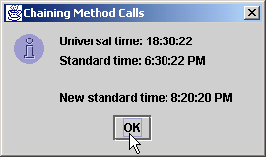
Time6.java

Slide 103
Finalizers
Garbage collection o recolección de basura
  Libera memoria de variables que ya no se usan
  Java lo hace automáticamente
    Un objeto está marcado para el basurero si ningún otro objeto lo referencia
Método Finalizer
  Devuelve recursos al sistema
  Java tiene el método finalize
    Definido en java.lang.Object
    Sin parámetors
    Retorna void

Slide 104
Miembros Static
static
  static se puede usar en variables (atributos)
    Variable de la clase, no del objeto
      Todos los objetos comparten la misma variable con el mismo valor

Slide 105
Employee.java
Line 6
Employee objects share one instance of count
Lines 23-28
Called when Employee is marked for garbage collection
1 // Fig. 8.20: Employee.java
2 // Employee class definition.
3 public class Employee extends Object {
4 private String firstName;
5 private String lastName;
6 private static int count; // number of objects in memory
7
8 // initialize employee, add 1 to static count and
9 // output String indicating that constructor was called
10 public Employee( String first, String last )
11 {
12 firstName = first;
13 lastName = last;
14
15 ++count; // increment static count of employees
16 System.out.println( "Employee object constructor: " +
17 firstName + " " + lastName );
18 }
19
20 // subtract 1 from static count when garbage collector
21 // calls finalize to clean up object and output String
22 // indicating that finalize was called
23 protected void finalize()
24 {
25 --count; // decrement static count of employees
26 System.out.println( "Employee object finalizer: " +
27 firstName + " " + lastName + "; count = " + count );
28 }
29
30 // get first name
31 public String getFirstName()
32 {
33 return firstName;
34 }
35
Employee objects share one instance of count
Called when Employee is marked for garbage collection

Slide 106
Employee.java
Lines 43-46 static method accesses static variable count
36 // get last name
37 public String getLastName()
38 {
39 return lastName;
40 }
41
42 // static method to get static count value
43 public static int getCount()
44 {
45 return count;
46 }
47
48 } // end class Employee
static method accesses static variable count

Slide 107
EmployeeTest.java
Line 13 EmployeeTest can invoke Employee static method, even though Employee has not been instantiated
1 // Fig. 8.21: EmployeeTest.java
2 // Test Employee class with static class variable,
3 // static class method, and dynamic memory.
4 import javax.swing.*;
5
6 public class EmployeeTest {
7
8 // test class Employee
9 public static void main( String args[] )
10 {
11 // prove that count is 0 before creating Employees
12 String output = "Employees before instantiation: " +
13 Employee.getCount();
14
15 // create two Employees; count should be 2
16 Employee e1 = new Employee( "Susan", "Baker" );
17 Employee e2 = new Employee( "Bob", "Jones" );
18
19 // Prove that count is 2 after creating two Employees.
20 // Note: static methods should be called only via the
21 // class name for the class in which they are defined.
22 output += "\n\nEmployees after instantiation: " +
23 "\nvia e1.getCount(): " + e1.getCount() +
24 "\nvia e2.getCount(): " + e2.getCount() +
25 "\nvia Employee.getCount(): " + Employee.getCount();
26
27 // get names of Employees
28 output += "\n\nEmployee 1: " + e1.getFirstName() +
29 " " + e1.getLastName() + "\nEmployee 2: " +
30 e2.getFirstName() + " " + e2.getLastName();
31
EmployeeTest can invoke Employee static method, even though Employee has not been instantiated

Slide 108
EmployeeTest.java
Line 40
Calls Java’s automatic garbage-collection mechanism
32 // If there is only one reference to each employee (as
33 // on this example), the following statements mark
34 // those objects for garbage collection. Otherwise,
35 // these statement simply decrement the reference count
36 // for each object.
37 e1 = null;
38 e2 = null;
39
40 System.gc(); // suggest call to garbage collector
41
42 // Show Employee count after calling garbage collector.
43 // Count displayed may be 0, 1 or 2 depending on
44 // whether garbage collector executed immediately and
45 // number of Employee objects it collects.
46 output += "\n\nEmployees after System.gc(): " +
47 Employee.getCount();
48
49 JOptionPane.showMessageDialog( null, output,
50 "Static Members and Garbage Collection",
51 JOptionPane.INFORMATION_MESSAGE );
52
53 System.exit( 0 );
54 }
55
56 } // end class EmployeeTest
Calls Java’s automatic garbage-collection mechanism
Employee object constructor: Susan Baker
Employee object constructor: Bob Jones
Employee object finalizer: Susan Baker; count = 1
Employee object finalizer: Bob Jones; count = 0

Slide 109
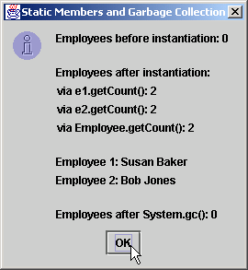
EmployeeTest.java

